Slide 1
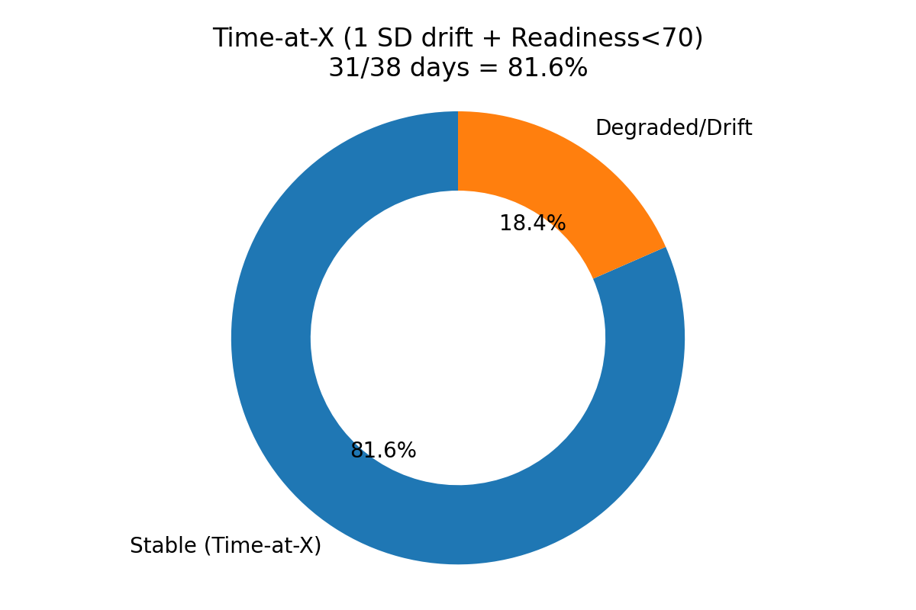
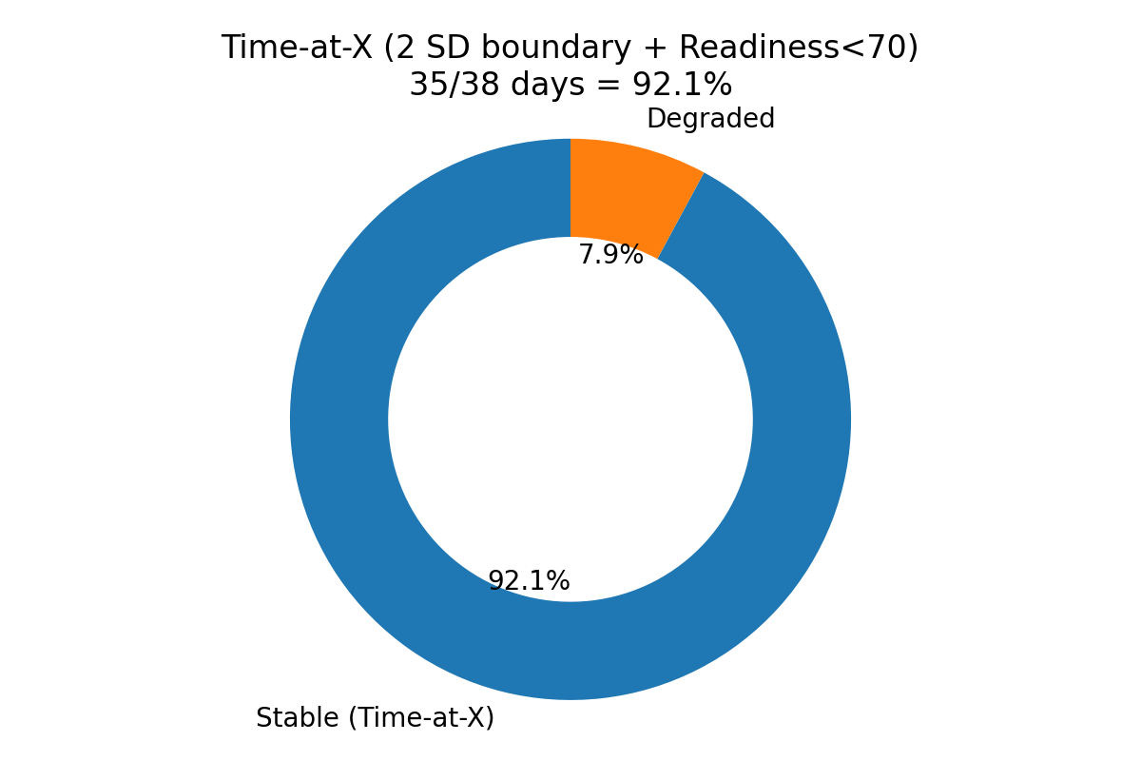
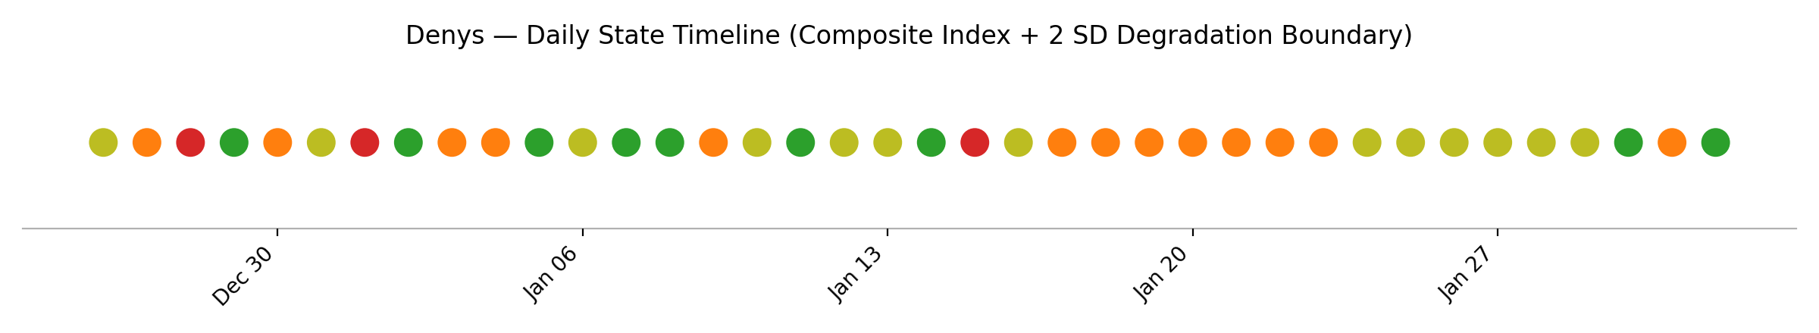
Human Capacity Risk Infrastructure — Denys (38 days)
Definition: X = highest sustainable cognitive bandwidth before measurable physiological degradation. H.U.L.K. governs and reports envelope state transitions.
92.1%
35/38
3
Time-at-X (2 SD boundary + Readiness<70)
Stable days
Degradation days (Dec 28, Jan 1, Jan 15)
Rigorous boundary + composite index
Sensitivity check (legacy drift heuristic)
Degradation trigger (daily):
• HRV < (14-day rolling mean − 2σ) OR
• Readiness Score < 70
Composite Index (CI):
CI = 0.35·z(HRV) + 0.45·z(Readiness) + 0.20·z(SleepHours)
State coloring (for timeline):
• GREEN: Stable + CI ≥ 0.5
• YELLOW: Stable + 0 ≤ CI < 0.5
• ORANGE: Stable + CI < 0
• RED: Degraded
Left: 1σ drift + Readiness<70 (more sensitive)
Right: 2σ boundary + Readiness<70 (more specific)
Custos / H.U.L.K. output: govern envelope (authority gating) + report time-at-X + audit state transitions for risk and performance correlation.

